Slide 1
Topology
Sana mateen

Slide 2
Topology
Topology defines the structure of the network of how all the components are interconnected to each other. There are two types of topology: physical and logical topology.
topology is the physical and logical arrangement of nodes and connections in a network.

Slide 3
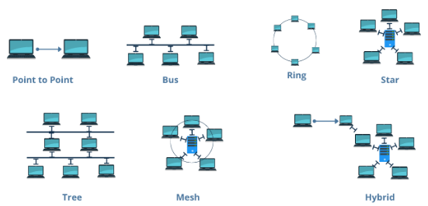

Slide 4
BUS TOPOLOGY
The bus topology is designed in such a way that all the stations are connected through a single cable known as a backbone cable.
Each node is either connected to the backbone cable by drop line through a tap.
When a node wants to send a message over the network, it puts a message over the network.
All the stations available in the network will receive the message whether it has been addressed or not.
The bus topology is mainly used in 802.3 (ethernet) and 802.4 standard networks.
The configuration of a bus topology is quite simpler as compared to other topologies.
The most common access method of the bus topologies is CSMA (Carrier Sense Multiple Access).
It is a media access control used to control the data flow so that data integrity is maintained, i.e., the packets do not get lost.

Slide 5
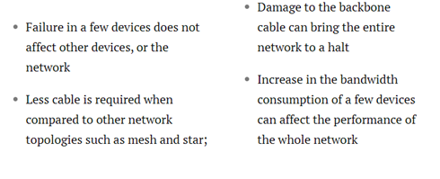

Slide 6
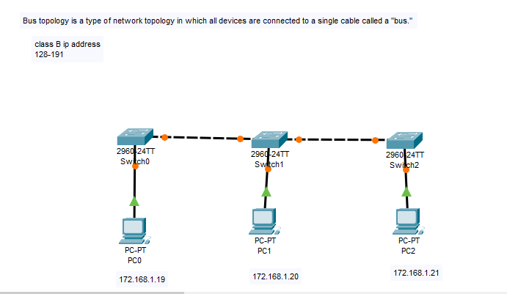

Slide 7
Ring Topology
In a ring topology, each node is linked with its neighbor to form a closed network.
This configuration sees the data move from one node to another, either unidirectionally or bidirectionally.
Such network topology is used in smaller networks, like those in schools.
Many ring networks use token passing to regulate data flow.
In such an arrangement, a token is transferred from one device to the next, and only the node with the token can transmit data.
The device that receives the data from the token sends it back to the server along with an acknowledgment.
Only an endpoint with access to an ’empty’ token can transmit data at a given time, while the other computers have to wait for their turn.

Slide 8
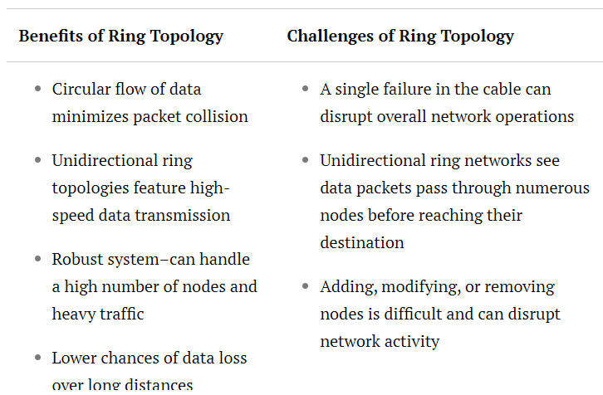

Slide 9
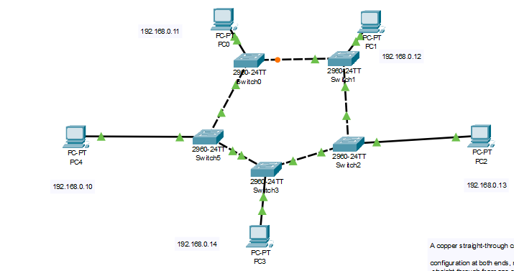

Slide 10
FastEthernet is a LAN transmission standard
it has data transmission rate of 100 Mega Bits Per Sec
Copper crossover cables, on the other hand, feature different pin configurations at each end. These cables are designed for connecting similar devices directly to each other
A copper straight-through cable is perhaps one of the most commonly used network cables. It’s characterized by the same pin
configuration at both ends, meaning the wires in the cable are connected
straight through from one end to the other.

Slide 11
Star topology
In a star topology, all nodes are connected to a central hub using a communication link.
Each node needs a separate wire to establish a point-to-point connection with the hub, which functions as a server to control and manage the entire network.
In such a configuration, if one endpoint wants to transmit data to another endpoint, it must send the request to the central hub, forwarding the message to the intended recipient.

Slide 12
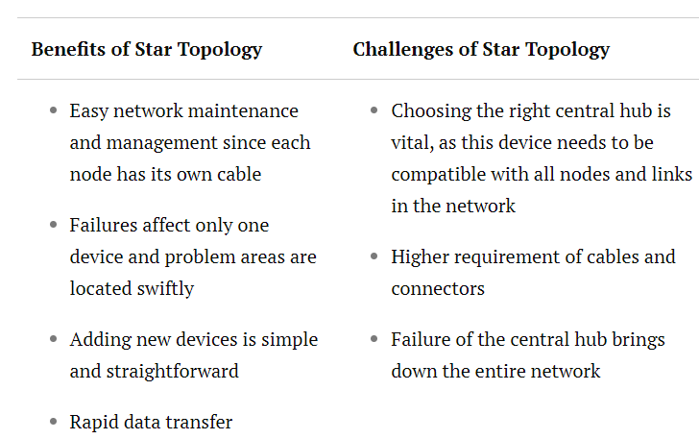

Slide 13
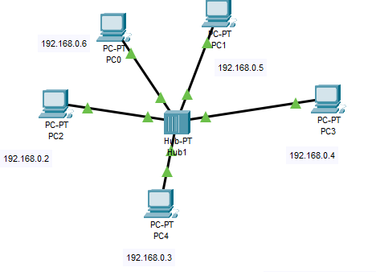
A hub is a networking device that connects multiple devices together. Hubs are also known as repeaters

Slide 14
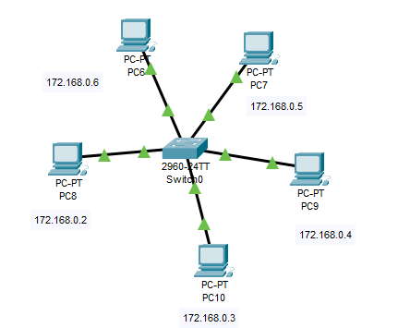
a switch is a piece of hardware that connects devices on a network.
It uses packet switching to forward data from source ports on devices to destination ports on other devices

Slide 15
Mesh topology
In a mesh topology, all the nodes are interconnected and can send and receive their data and relay data from other nodes.
Full mesh networks, wherein each node is connected to every other node, are usually reserved for critical networks as they are extremely costly to implement and challenging to maintain

Slide 16
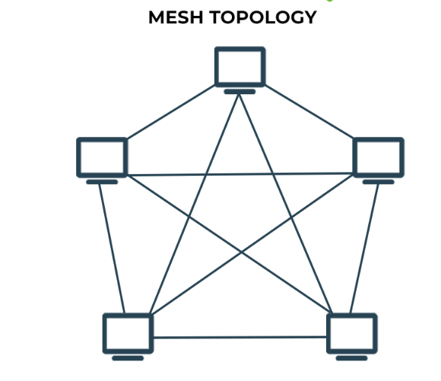

Slide 17
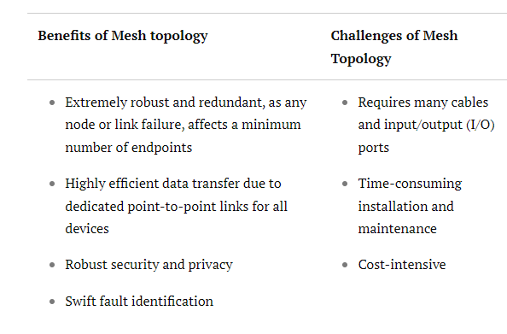

Slide 18
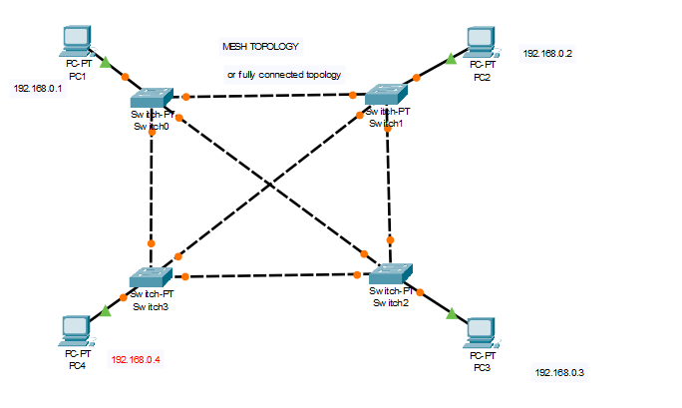

Slide 19
Hybrid topology
A hybrid network topology, as the name suggests, features characteristics of multiple other topologies.
The creation of such a configuration depends on the requirement of the network.
Two most commonly used hybrid topologies are star-ring and star-bus.
In the former, the central hubs of multiple star topologies are linked using a ring topology.
In the latter, the hubs of numerous star topologies are connected using a bus topology.

Slide 20
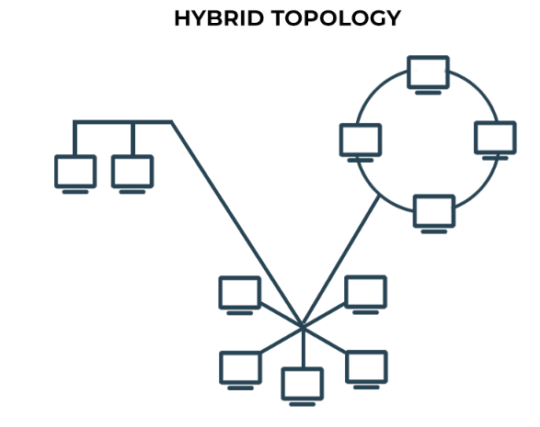

Slide 21
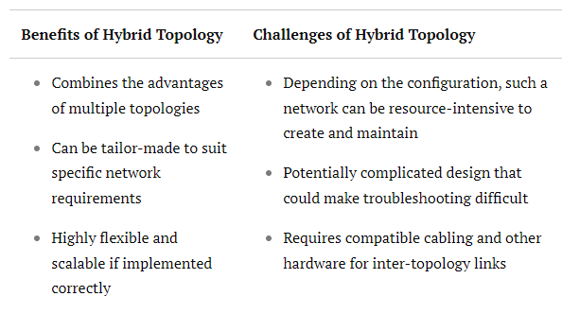

Slide 22
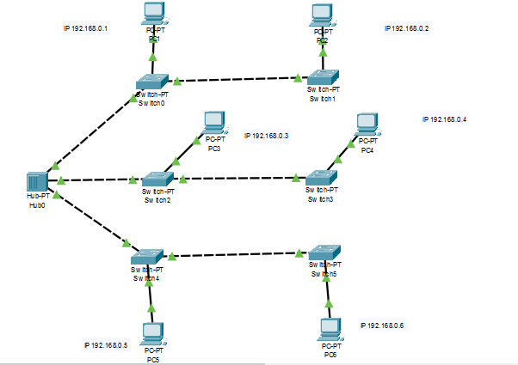

Slide 23
Tree topology
In a tree topology, nodes are arranged in a configuration that resembles a tree’s leaves, branches, and trunk.
Endpoints, or ‘leaves,’ are connected to mid-level nodes or ‘branches’ linked to the tree’s ‘trunk.’
The trunk is the backbone connection that links multiple mid-level nodes.

Slide 24
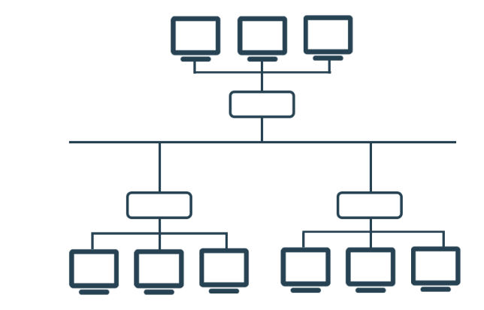

Slide 25
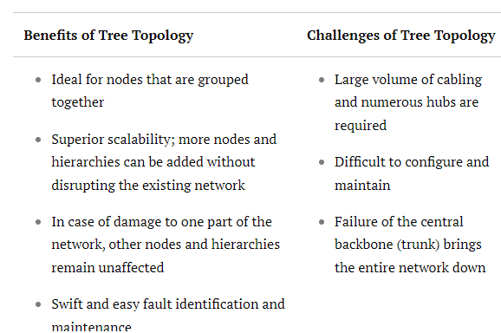

Slide 26
